Slide 1
Assets That Could Be Included
Stocks
Bonds
Mutual funds
Exchange traded funds
Brokerage investment accounts
Partnership ownership interests
Certain passive business equity interests
Comparable financial assets
.4% Uniform Tax

Slide 2

#1
This Tax Would Make Housing
Less Affordable

Slide 3
#2
This Tax Could Drive Out Local Rental Property Owners, Usher In Wall St. Investors

Slide 4
#3
LLCs and Rental Properties Are Retirement Investment Vehicles

Slide 5
#4
This Tax Would Discourage Investment and Housing Inventory

Slide 6
#5
To Look Forward, Let’s Look Back

Slide 7
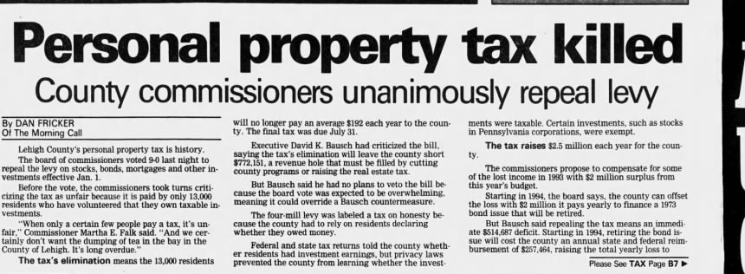

Slide 8
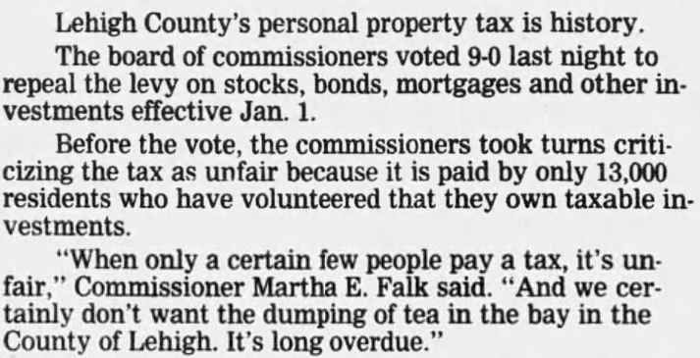

Slide 9
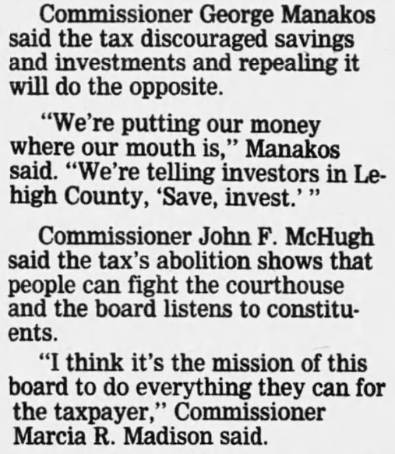

Slide 10
